Slide 1
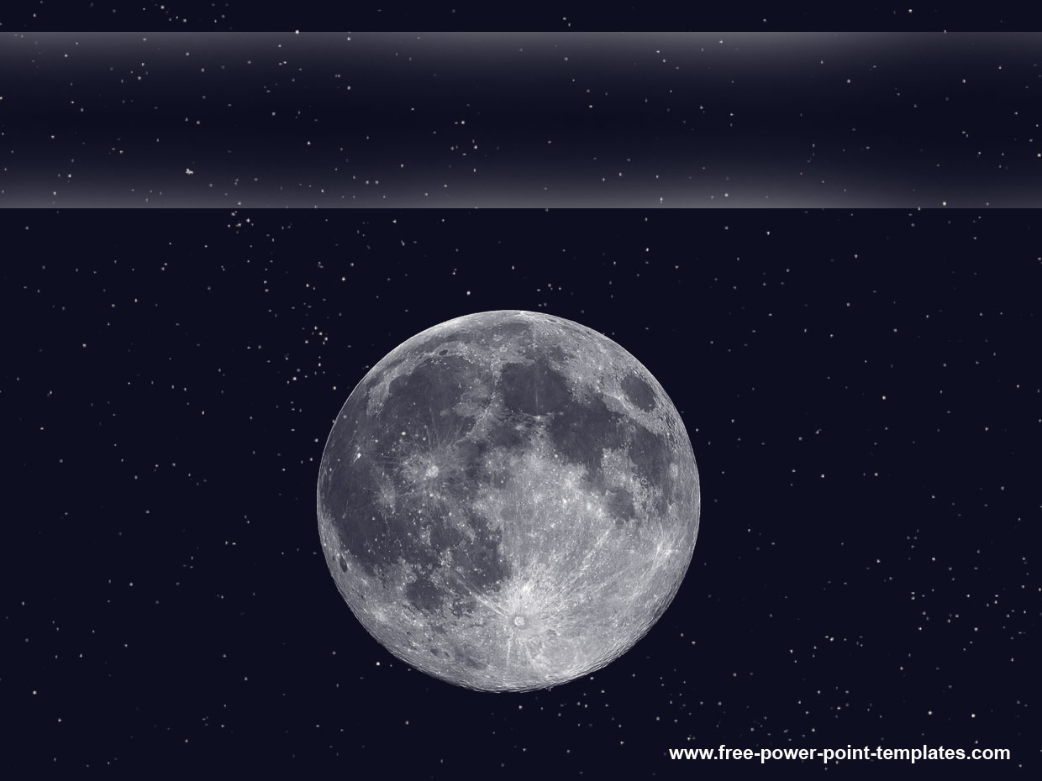

Lunar Lander Georgia Institute of Technology CS 7642 – Reinforcement Learning Summer 2017 James Chan
Source code sharing subject to Georgia Tech Honor Code restriction. Available for private viewing upon request. Lunar Lander is intellectual property of OpenAI

Slide 2
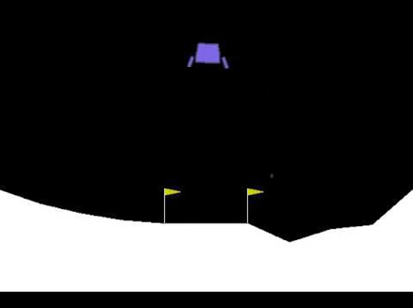
Overview
CS7642 – Reinforcement Learning has adopted the Lunar Lander problem on OpenAI Gym as one its three projects. The Lander has 3 states: X position, Y position, and orientation. It has also 3 possible actions: left throttle, right throttle, and up throttle. In each episode the lander will start randomly above the ground. The episode restarts when the lander has crashed. Once the lander has landed successfully in the flagged zone for , the problem is considered solved.
X
Orientation
Left throttle -1 reward
Right throttle
-1 reward
Up throttle
-1 reward
Landing Zone +100 reward
Y

Slide 3
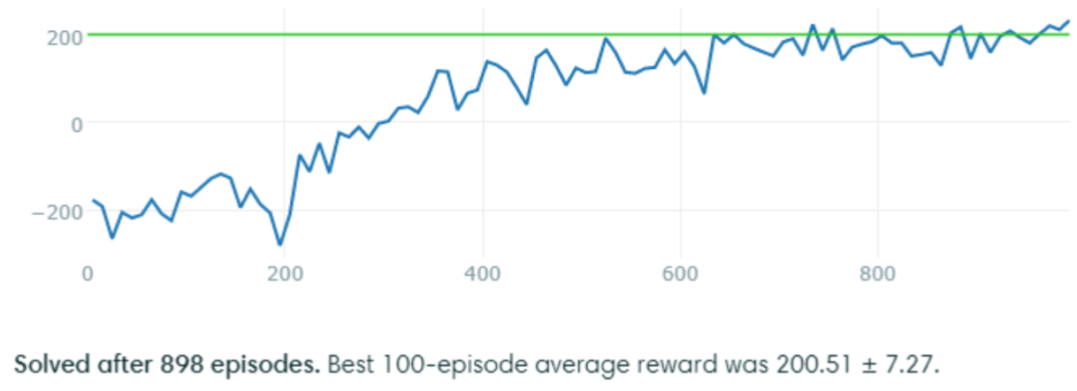
Solution
Approach:
Q-Learning with experience replay and neural network as non-linear function approximator. Q-learning portion implemented in python and neural network implemented using Keras.
Result:
Converged in approximately 900 steps. A steady climb in total reward is observed.

Slide 4
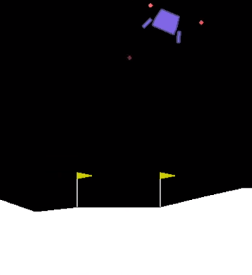
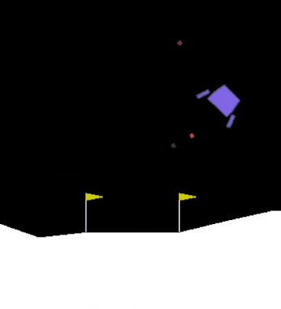
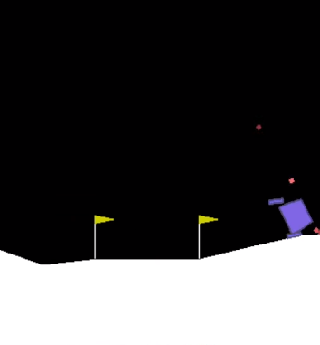
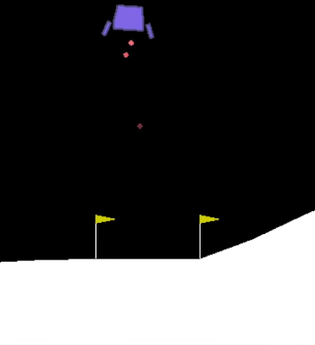
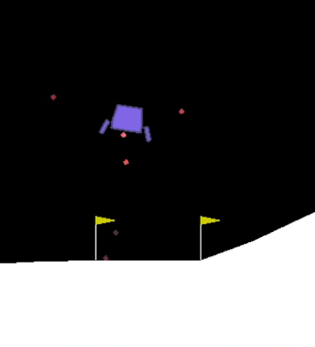
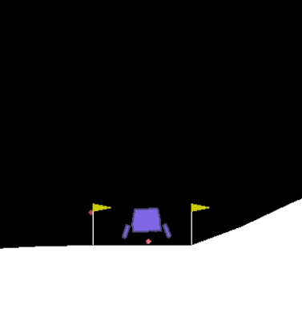
Model Training – Before vs. After
Episode 1 - Start
Episode 1 – End
Total reward: -189
Episode 377 - Start
Episode 377 – End
Total reward: +123

Slide 5
Unsuccessful Attempts
The following algorithms were attempted and unable to solve the Lunar Lander problem. It is concluded that the solution may not be modeled by linear estimators.
SARSA with linear function estimator
Q-learning with linear function estimator

